Slide 1
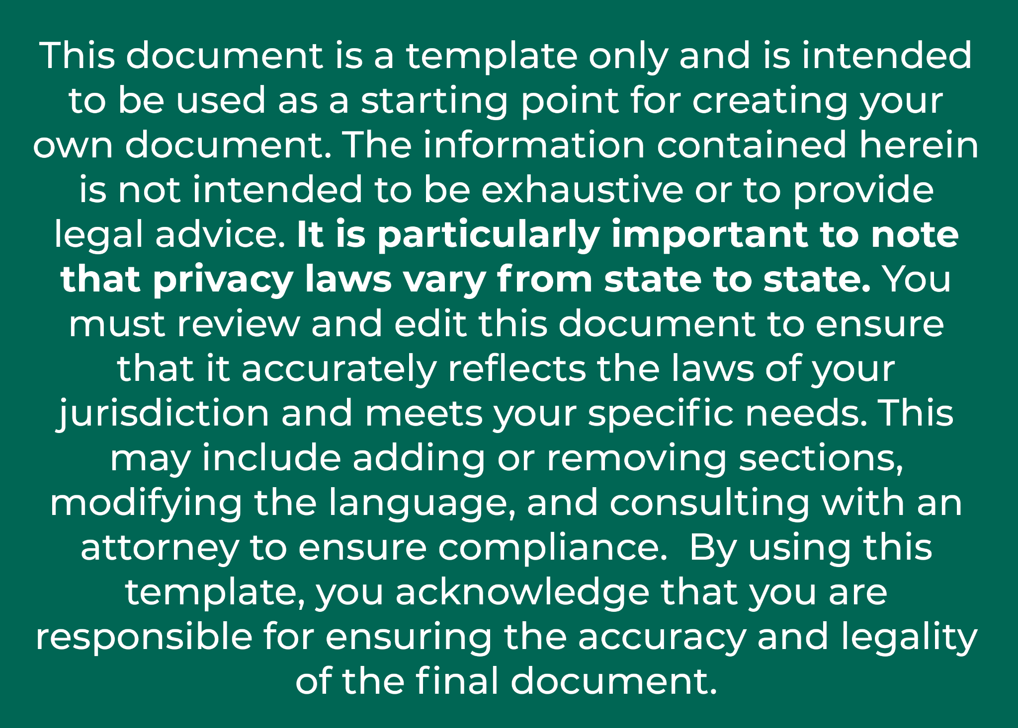
Make sure your care team has all of the information they need to provide you with the best care possible.
Ask any member of our team how you can decide who has access to your health information.
[Organization Logo/Name]
Contact Us:
[Phone Number]
[Email Address]
[Organization Address]
Your health.
Your data.
Your care.

Slide 2
BENEFITS
Enables your providers to make better decisions. Your providers — including your primary care provider, specialists, and hospital staff — can quickly and safely access important health information, whether you’re at home or traveling in the U.S.
Supports more efficient and effective care.
With less time wasted on tracking down your test results and other health information, your healthcare providers can spend less time on paperwork and more time on your care.
Helps you in case of emergency.
In the event of an emergency, authorized medical staff can quickly access your allergies, medications and health problems, allowing them to care for you without delay.
At [organization name], we’re serious about data privacy and security. That’s why we allow you to decide who has access to your data.
We believe that your health data should be available to you and your care providers regardless of where care was provided, which is why we practice the safest, most secure form of health data sharing.
When you choose to share your health information, you can be confident that only individuals and organizations authorized by law can access it for legitimate purposes. You can also trust that data is protected end-to-end — so no one else can see it.
By “opting in” to secure data sharing, you ensure that clinicians providing care for you at other organizations have the information they need to make the best and safest care decisions for you.
FREQUENTLY ASKED QUESTIONS
How can I be sure my data is safe?
Electronic sharing is much more secure than a fax or paper file, which can be lost or viewed by unauthorized persons. Access to your electronic health data is tightly controlled and monitored.
Who can see my information?
Under HIPAA, your health records are kept private and secure, allowing only authorized providers to access them. You can choose which care teams may access and share your health information to better coordinate your care.
What information is shared?
Important patient health information, such as medical history, test results, and medication lists may be shared, empowering your care team to make better treatment decisions and ensuring that you receive coordinated care. Access to the right information allows providers to work together more effectively to support your health.

